Slide 1
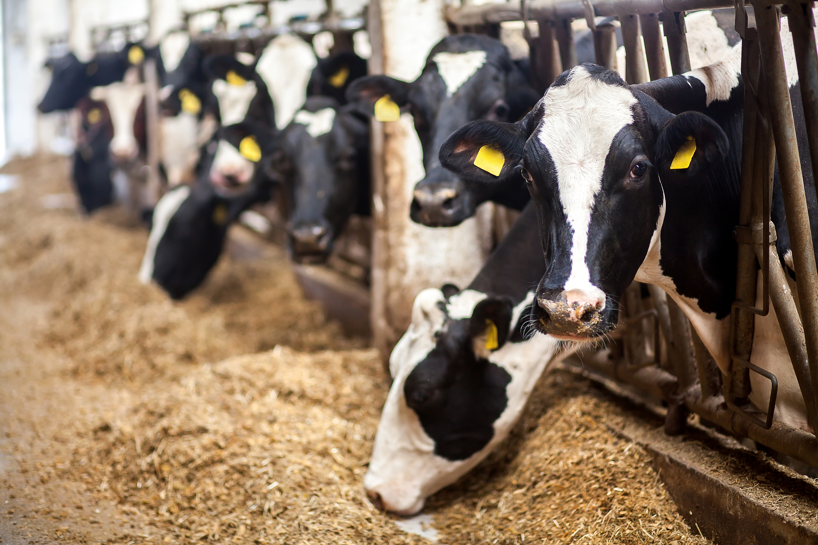
FARMED ANIMAL WELFARE & THE LAW: UNITED STATES
Dr Rajesh K. Reddy
Center for Animal Law Studies
Email: rajreddy@lclark.edu

Slide 2
COMPARATIVE ANIMAL LAW: FARMED ANIMALS
This presentation is part of the Animal Law Education (ALE) module, Comparative Animal Law: Farmed Animals.
Created by Voiceless, the animal protection institute in collaboration with the Centre for Professional Legal Education & the Center for Animal Law Studies.
www.voiceless.org.au

Slide 3
Learn more at:
www.voiceless.org.au
OVERVIEW
History
Statistics
A brief overview of the United States’ role in the emergence of industrial animal agriculture
An appraisal of the staggering numbers of animals killed for food in the United States
The Law
Reform
A critical analysis of the flawed-by-design framework to protect the interests of farmed animals
An insight into novel legal efforts by animal advocates to improve protections for farmed animals

Slide 4
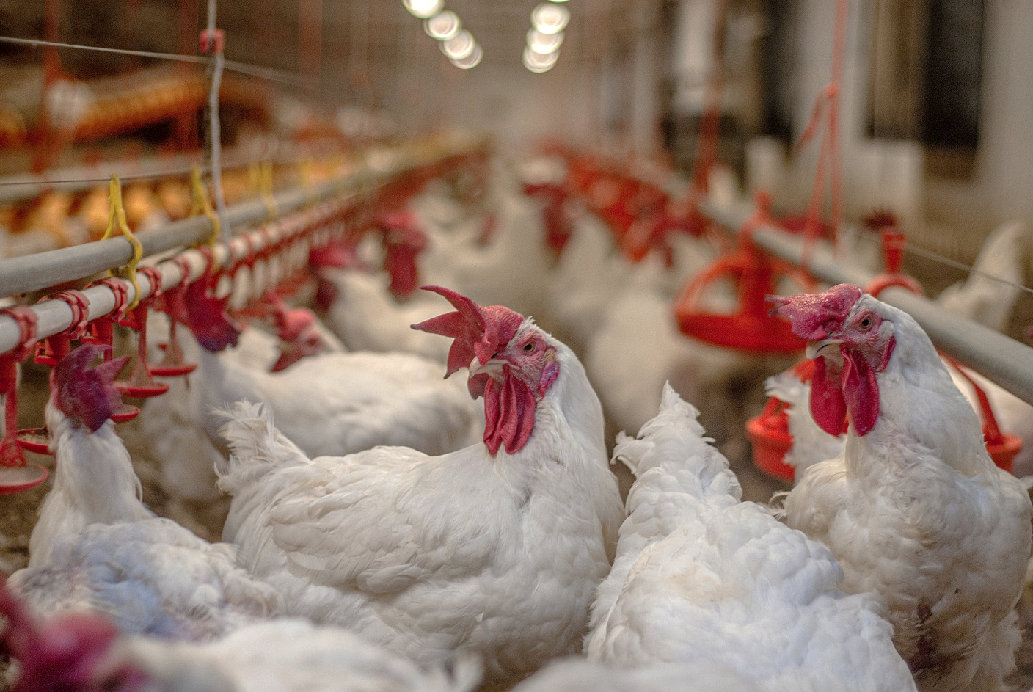
HISTORY
Scientific Developments
Vaccines and Vitamin D
Animal Husbandry
Refrigeration
The Impact of War
The ‘High Cost of Living‘
A ‘Wonder Drug’
Industrialisation
Vertical Integration
Routinised Cruelties
Stefano Belacchi / We Animals Media

Slide 5
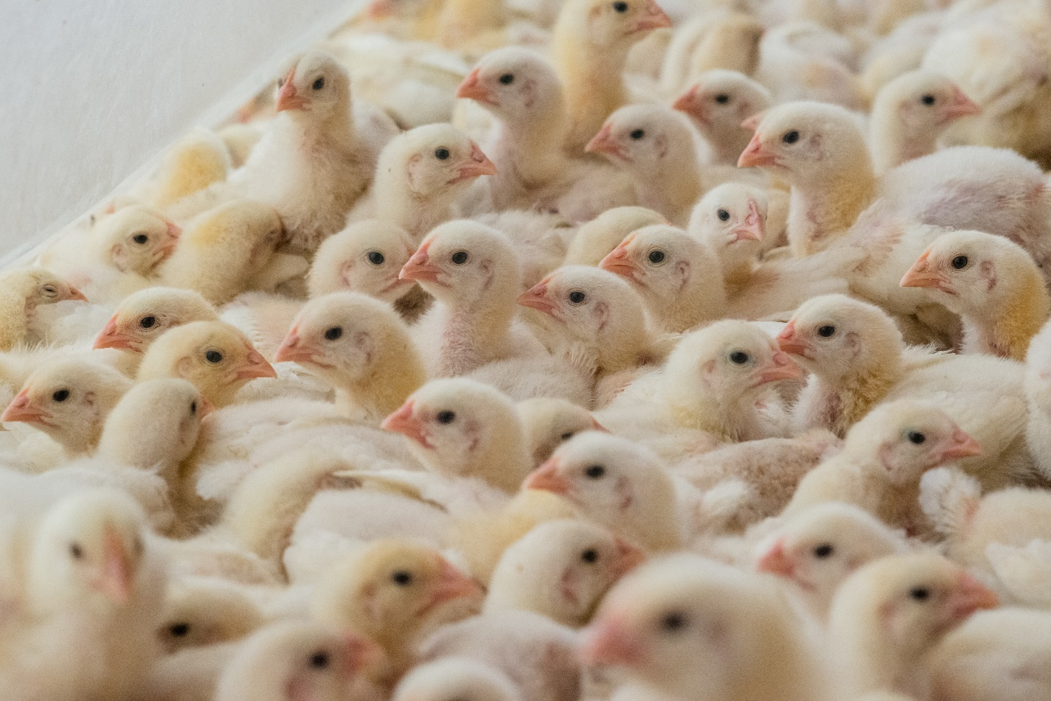
STATISTICS: US FARMED ANIMAL USE
Cows: 33,000,000
Pigs: 129,000,000
Broiler chickens: 9,000,000,000
Egg-laying hens: 100,000,000
Turkeys: 200,000,000
Lambs and sheep: 2,000,000
Finned aquatic animals: 3,800,000,000
Shellfish: 43,100,000,000
Jo-Anne McArthur / Animal Equality / We Animals Media

Slide 6
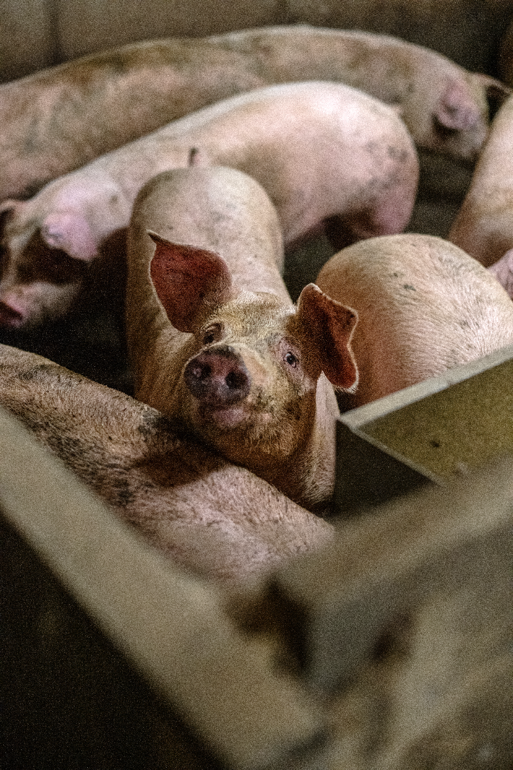
LAW: REARING
No Federal Protections
State Law Loopholes
Farmed animals don’t qualify as animals
Customary husbandry practices exempted
Case Study: NJSPCA v. New Jersey Ag. Dep’t
Jo-Anne McArthur / We Animals Media

Slide 7
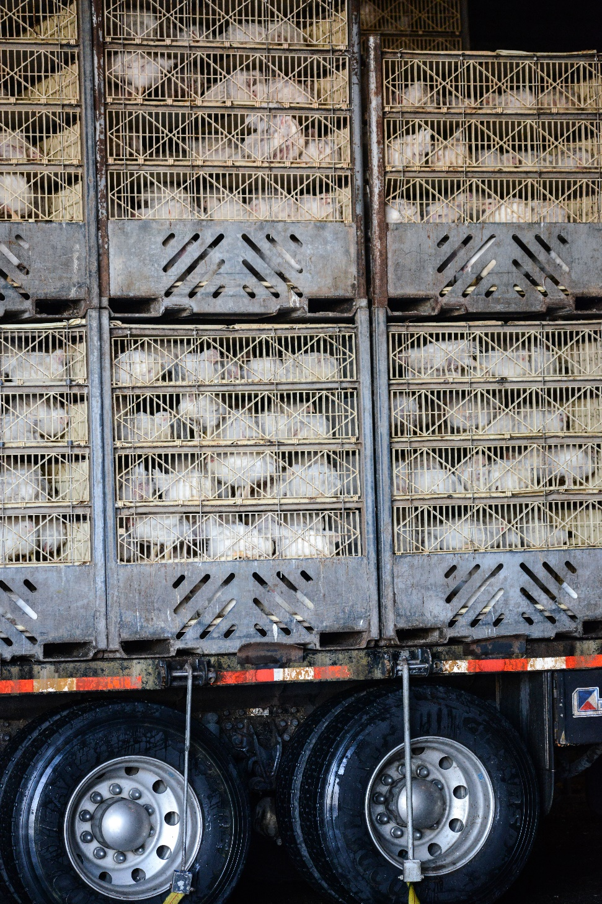
LAW: TRANSPORT
National Twenty-Eight Hour Law
Carriers to provide food, water, rest every 28 hours
Land transport of animals across state lines only
Only pigs, sheep, and cattle (also equines for slaughter)
Time may be extended
Fragmented state laws
Jo-Anne McArthur / We Animals Media

Slide 8
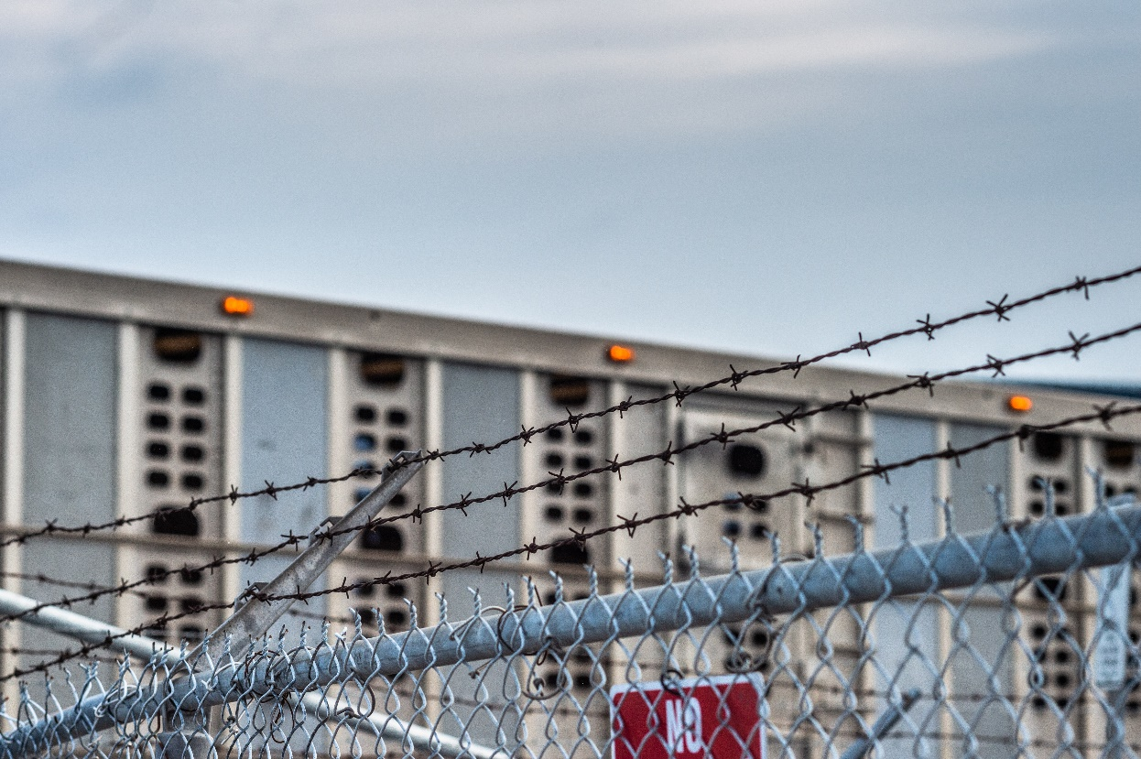
LAW: SLAUGHTER
1906: Federal Meat Inspection Act (FMIA)
1957: Poultry Production Inspection Act (PPIA)
1958: Humane Methods of Slaughter Act (HMSA)
1978: Humane Methods of Slaughter Act Amendment
2005: Federal Meat Inspection Act Amendment
Case Studies:
National Meat Association v. Harris
Cavel International, Inc. v. Madigan
Jo-Anne McArthur / We Animals Media

Slide 9
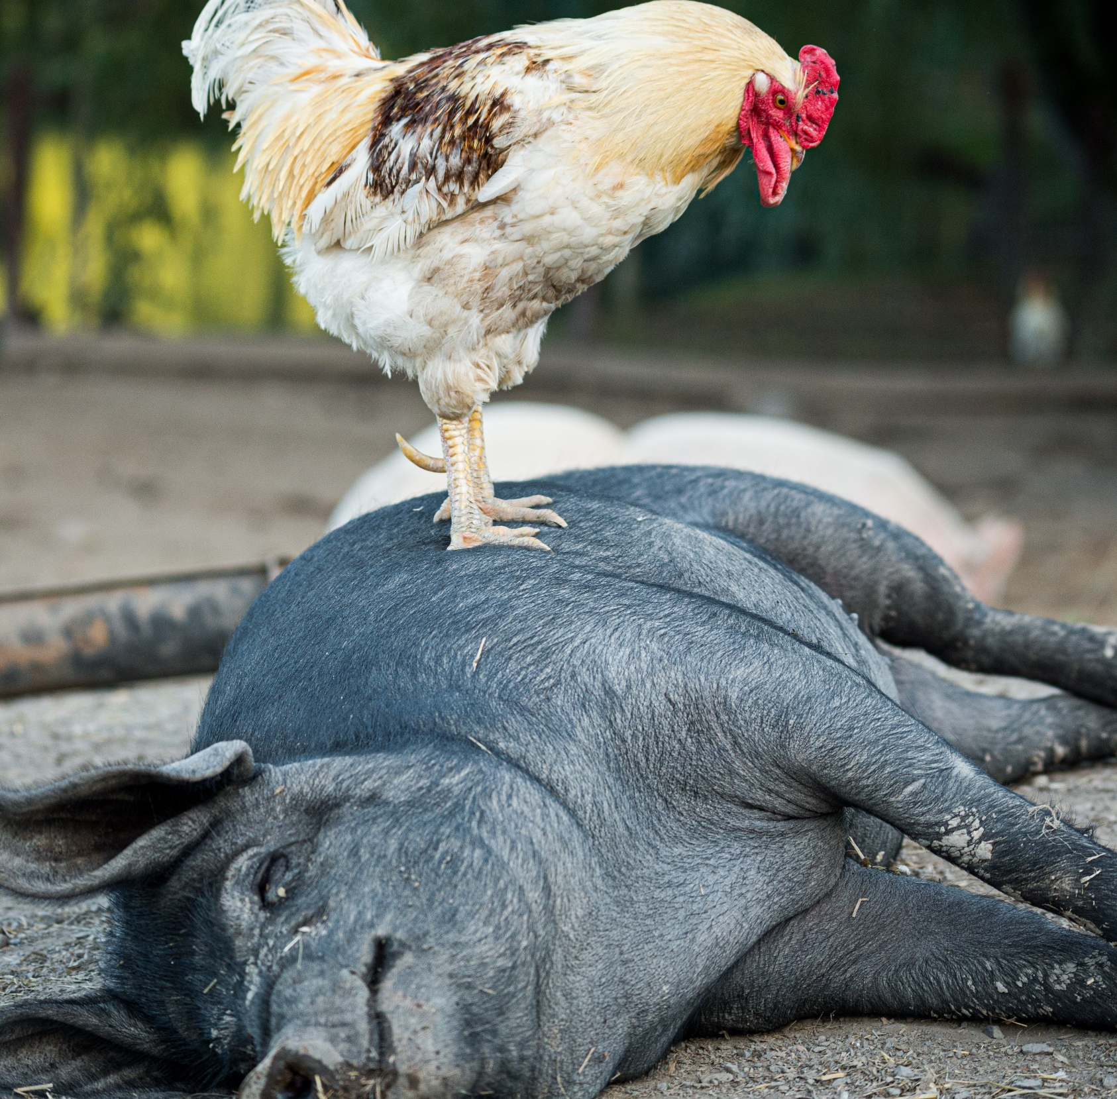
REFORM
Ag-Gag Laws
Recording Bans
False Pretenses for Employment
Quick Reporting Law
State-Based Ballot Initiatives
Florida, California
False Advertising
Case Study: Barnes v. Tillamook
Factory farming, Human Diseases
Jo-Anne McArthur / We Animals Media

Slide 10
THANK YOU!
Queries about the presentation can be directed to
Dr Rajesh K. Reddy: rajreddy@lclark.edu
To learn more about Animal Law Education (ALE) visit: www.voiceless.org.au/animal-law/
To contact Voiceless: info@voiceless.org.au
© Voiceless, the animal protection institute 2021

