Slide 1
Navigating NAPLAN
A Voiceless Teaching and Learning Program Years 7 & 9
Persuasive Writing
LESSON 4
Bringing it together

Slide 2
Structuring your essay
Once you have planned out your arguments, you can plan out your essay structure.
What is the most persuasive and logical way to structure your essay?

Slide 3
Structuring your essay
Generally, your essay should follow this structure:
Introduction
Argument One
Argument Two
Argument Three
Conclusion
Remember to leave 5 minutes for planning and 5 minutes for editing/proofing

Slide 4
Writing an introduction
Your introduction should communicate:
The background to the issue, and what statement or question you are addressing;
Your position in response to the question or statement provided (‘thesis statement’);
How you will support this position (i.e. the arguments you will make);
How your essay will be structured (i.e. the order of your arguments);
What you will conclude and why the reader should agree with you.

Slide 5
What do you think of this introduction?
Each year in Australia, between 11-12 million hens are confined in small cages to produce eggs for human consumption. This method of egg production is unacceptable, as it causes numerous welfare issues for these hens. This essay argues that battery cages should be banned in Australia. Firstly, it argues that battery cages have been banned in countries overseas, and Australia should follow this example by phasing out battery cage eggs. Secondly, it argues that there are higher welfare alternatives that should be used instead, such as organic egg farming. Finally, it argues that we have an ethical duty to minimise pain and suffering to sentient animals.

Slide 6
What comes next?

Slide 7
Body of the essay
This is where you write out the arguments you prepared in the planning stage.
You must try to present these arguments as persuasively as possible.
Try to convince the reader to agree with your position, so that your conclusion seems inevitable.

Slide 8
Writing an effective conclusion
Summarise your key arguments.
Make sure that you do not introduce any new information.
The conclusion should simply summarise your arguments and show the reader how you have reached your conclusion.
Be persuasive - end on a convincing note.

Slide 9
Example of an inadequate conclusion
In summary, as you can see, Australia should definitely ban battery cage egg production. For the reasons discussed above, battery cage egg production should not be allowed to continue.

Slide 10
Example of an inadequate conclusion
Why is this inadequate? Is it very persuasive? Does it help the reader to remember all of the key arguments, and why they support this conclusion?
In summary, as you can see, Australia should definitely ban battery cage egg production. For the reasons discussed above, battery cage egg production should not be allowed to continue.

Slide 11
Example of an inadequate conclusion
This essay has argued that Australia should ban battery cage egg production for two main reasons.
Firstly, it was demonstrated that this system of production has significant welfare impacts on layer hens which are unacceptable in modern Australian society.
Secondly, it was argued that most Australians oppose animal cruelty, and do not support such practices.
Is this version better? What improvements have been made? How could it be improved further?

Slide 12
Consider the NAPLAN Minimum Standards (Year 7)
Excerpt from The National Assessment Program website: https://www.nap.edu.au/naplan/writing/minimum-standards#year7

Slide 13
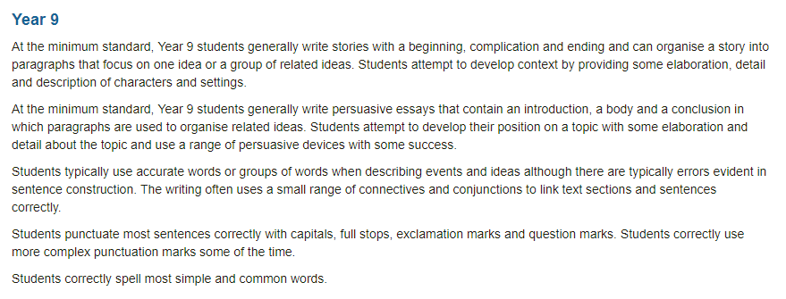
Consider the NAPLAN Minimum Standards (Year 9)
Excerpt from The National Assessment Program website: https://www.nap.edu.au/naplan/writing/minimum-standards#year9

