Slide 1
Navigating NAPLAN
A Voiceless Teaching and Learning Program Years 7 & 9
Narrative Writing
LESSON 11
Write here, write now!

Slide 2
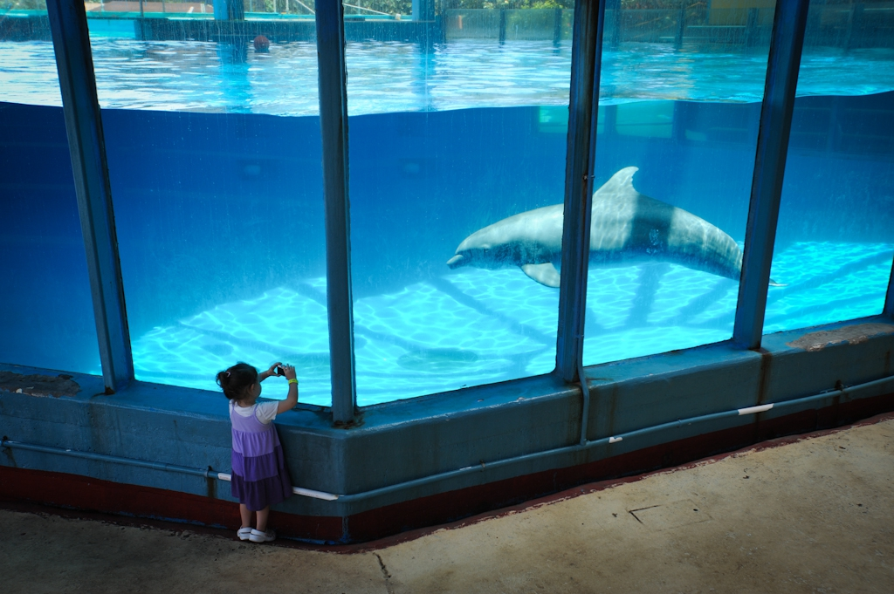
The Dolphin in the Tank
Today you are going to write a narrative or story.
The idea for your story is “The Dolphin in the Tank”.
Why is there a dolphin inside the tank?
Is the dolphin happy? Is the dolphin upset?
How did the dolphin get there?
What happens in your story if the dolphin is let out of the tank?
Photo: We Animals/Jo-Anne Mcarthur
Hint: you may find the Dolphins in Captivity Fact Sheet helpful.
Adapted and modified from: https://www.nap.edu.au/_resources/NAP_website_example_writing_prompt_narrative_The_Box.pdf

Slide 3
The Dolphin in the Tank
Write a narrative piece of writing based on this prompt.
Remember…
5 minutes planning
30 minutes writing
5 minutes editing
Photo: We Animals/Jo-Anne Mcarthur
Hint: you may find the Dolphins in Captivity Fact Sheet helpful.

Slide 4
Additional writing prompts

Slide 5
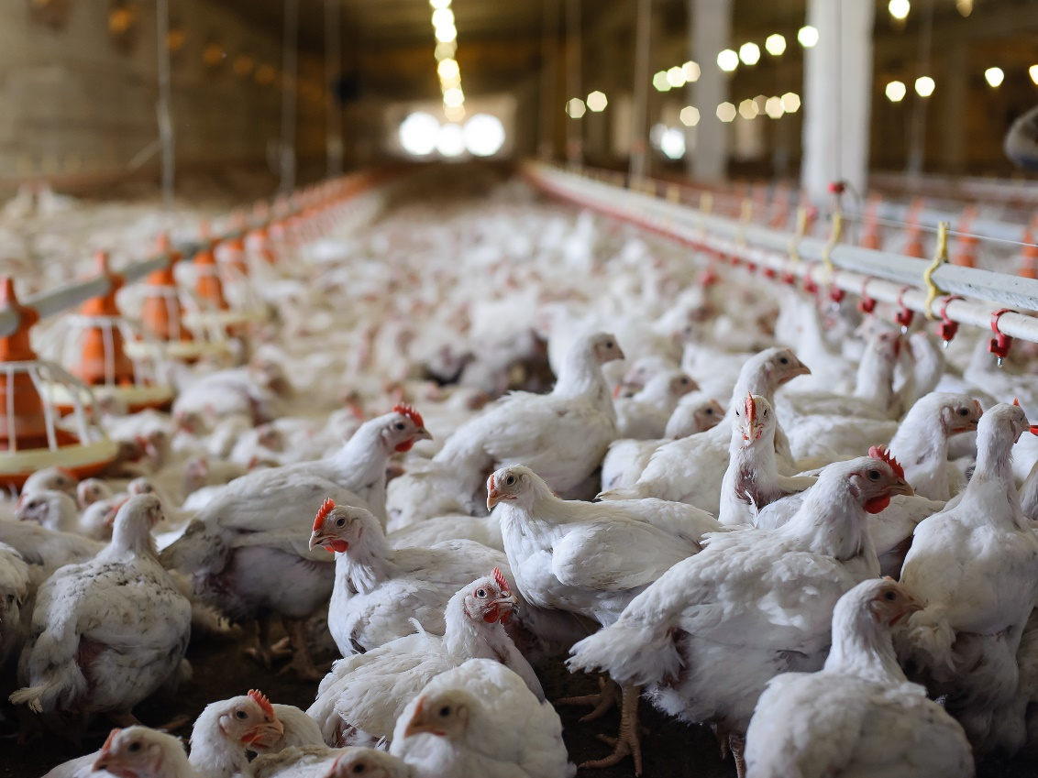
The Chicken in the Shed
Today you are going to write a narrative or story.
The idea for your story is “The Chicken in the Shed”.
Why are there chickens in the shed?
How do they feel? Do they interact with each other?
Why are they there?
What happens in your story if the chickens go outside?
Hint: you may find the Broiler Chicken Welfare Fact Sheet helpful.
Adapted and modified from: https://www.nap.edu.au/_resources/NAP_website_example_writing_prompt_narrative_The_Box.pdf

Slide 6
The Chickens in the Shed
Write a narrative piece of writing based on this prompt.
Remember…
5 minutes planning
30 minutes writing
5 minutes editing
Hint: you may find the Broiler Chicken Welfare Fact Sheet helpful.

Slide 7
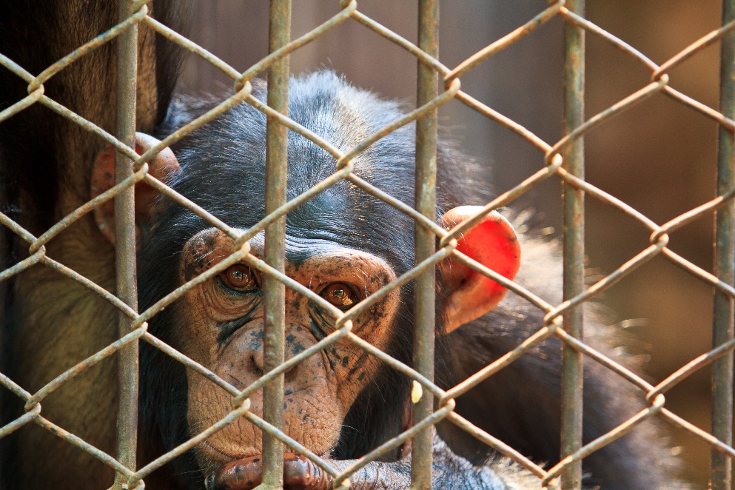
The Chimp in the Circus
Today you are going to write a narrative or story.
The idea for your story is “The Chimp in the Circus”.
Why is the chimpanzee in the circus? Why is he kept in a cage?
How does the chimpanzee feel?
Why is he there?
What happens in your story if he escapes the circus?
Hint: you may find the Legal Personhood Fact Sheet helpful.
Adapted and modified from: https://www.nap.edu.au/_resources/NAP_website_example_writing_prompt_narrative_The_Box.pdf

Slide 8
The Chimp in the Circus
Write a narrative piece of writing based on this prompt.
Remember…
5 minutes planning
30 minutes writing
5 minutes editing
Hint: you may find the Legal Personhood Fact Sheet helpful.

